Slide 1

CityTwin – AI-Powered City Hazard Precaution Engine
An SDLC-Based AI System for Urban Safety
Coding and Decoding Problem Solving | Software Development Life Cycle Implementation
Team Members:
Akhil Chiluvari | 25RBAIM0038 Yashwanth Talari | 25RBAIM0047 Jitendra Durga Prasad Medisetti | 25RBAIM0007 Narsimha Katikeri | 25RBAIM0008

Slide 2
The Problem: Cities Under Constant Threat
Urban centers worldwide face mounting challenges from environmental hazards and infrastructure risks. Critical information remains fragmented across multiple agencies, arriving too late to prevent damage.
Flooding Events
Sudden storms overwhelm drainage systems
The current reality: Communities react to disasters after they strike, rather than preparing beforehand. Early warning systems exist but fail to provide actionable guidance for residents and city planners.
Heat Waves
This reactive approach costs lives, damages property, and strains emergency resources that could be better allocated with advance notice.
Extreme temperatures endanger vulnerable populations
Air Quality
Pollution spikes impact public health
Infrastructure Risks
Aging systems require predictive maintenance

Slide 3

The Solution: CityTwin Intelligence
Digital Twin Technology
Predictive AI Analysis
Analyze patterns to forecast hazards before they materialize
Create a virtual replica of urban infrastructure and environmental conditions
Actionable Precautions
Deliver specific safety guidance instead of generic warnings
Impact Statement: Transform urban safety from reactive emergency response to proactive hazard prevention through intelligent prediction and clear communication.

Slide 4




How CityTwin Works
Data Collection
AI Analysis
Weather patterns, traffic flow, air quality sensors, infrastructure status
Machine learning algorithms identify risk patterns and probability
Risk Assessment
Precaution Delivery
Calculate hazard levels with confidence scores
Specific recommendations for residents and authorities
The system operates continuously, updating predictions as new data streams in. Users receive real-time hazard assessments tailored to their specific location and circumstances, enabling informed decision-making before conditions deteriorate.

Slide 5
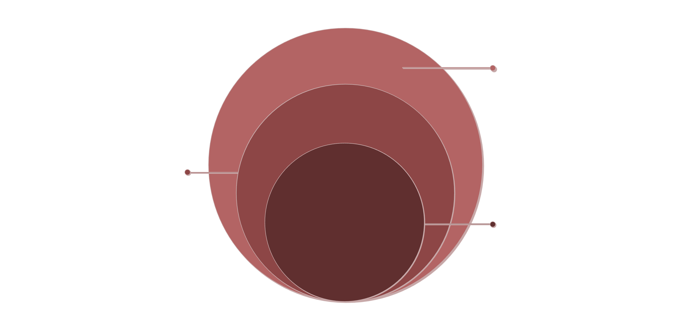
System Architecture
Frontend Layer
Backend Layer
AI Engine
Responsive web interface
RESTful API endpoints
Pre-trained ML model
Interactive city map visualization
Data processing pipeline
Feature extraction algorithms
Real-time hazard display
Business logic implementation
Prediction generation
User-friendly data entry forms
Database management
Confidence scoring system
Frontend
Responsive web interface and map UI
Backend
Python API server and data processing
AI Model
Prediction engine for hazard forecasting

Slide 6


AI Prediction Engine Explained
01
02
Historical Data Training
Pattern Recognition
The model learns from past hazard events, weather patterns, and city responses across multiple years of data
Advanced algorithms identify correlations between environmental factors and hazard occurrence
03
04
Probability Calculation
Continuous Learning
Statistical analysis generates likelihood scores for potential hazards within specified timeframes
The system improves accuracy over time by incorporating new data and outcomes from previous predictions
No complex mathematics required: The AI operates transparently, providing explainable predictions that city officials and residents can understand and trust.

Slide 7
SDLC Methodology Applied
Requirements Analysis
1
Defined system objectives, user needs, and technical specifications through stakeholder interviews and research
2
System Design
Created architecture blueprints, database schemas, API contracts, and user interface mockups
Implementation
3
Developed frontend, backend, and AI components using modern frameworks and best coding practices
4
Testing & Validation
Conducted unit tests, integration tests, and user acceptance testing to ensure reliability
Deployment
5
Configured production environment and released working version with monitoring systems
6
Maintenance Plan
Established protocols for updates, bug fixes, and feature enhancements based on user feedback
This project demonstrates rigorous adherence to software engineering principles, not just theoretical knowledge.

Slide 8




Implementation: Building a Working System
Frontend Development
Technologies: HTML5, CSS3, JavaScript with responsive design framework
Created intuitive interface with real-time data visualization and mobile compatibility
Backend Development
Technologies: Python with Fast API framework, RESTful API architecture
Implemented robust data processing pipelines and secure API endpoints
AI Integration
Technologies: Scikit-learn and TensorFlow libraries for model deployment
Successfully integrated pre-trained model with real-time prediction capabilities
Key Achievement: This is not a prototype or concept—CityTwin is a fully functional system with actual data flow, API responses, and AI predictions running successfully.

Slide 9





Deployment Phase: From Code to Reality
Deployment Status
Environment Configuration
Set up development and production servers with proper security protocols
The system currently runs on localhost infrastructure with cloud-ready architecture. All components communicate seamlessly, processing requests and generating predictions in real-time.
System Integration
Technical Achievement: Successfully deployed a multi-tier application with AI capabilities, demonstrating end-to-end system development skills.
Connected frontend to backend APIs and verified data flow integrity
Model Deployment
Scalability ready: The modular architecture allows easy migration to cloud platforms like AWS or Azure for city-wide deployment.
Loaded trained AI model into production environment with optimization
Version Release
Successfully launched CityTwin v1.0 with monitoring and logging systems

Slide 10
User Journey: CityTwin in Action
1
Access Platform
User opens the CityTwin web application through any modern browser
2
Input Location Data
Select or enter city information and relevant environmental parameters
3
AI Processes Request
System analyzes data and generates hazard probability assessment
4
View Results
Dashboard displays hazard levels with color-coded risk indicators
5
Receive Precautions
Specific, actionable safety recommendations appear based on predicted risks

Slide 11




Key Features
AI-Based Hazard Prediction
Precaution Suggestions
Machine learning models analyze patterns to forecast potential urban hazards before they occur, enabling proactive response strategies.
Context-aware recommendations provide actionable safety measures tailored to specific hazard types and severity levels.
Interactive UI
Scalable Architecture
Intuitive dashboard design ensures accessibility for all users, from city officials to everyday citizens seeking safety information.
Built with modular components and cloud-ready infrastructure to expand from pilot programs to city-wide deployment.

Slide 12

Understanding Our Limitations
Data Quality Dependency
Model accuracy relies heavily on comprehensive, high-quality historical data sources. Incomplete datasets can affect prediction reliability.
Limited Real-Time Integration
Current prototype uses periodic data updates rather than continuous streaming from live sensors and weather stations.
Early-Stage Model
Our AI is in active development—we're continuously refining algorithms based on testing results and feedback loops.
Acknowledging these constraints demonstrates engineering maturity and guides our roadmap for improvement.

Slide 13





Future Scope: Where CityTwin is Heading
Live Data Integration
Connect to real-time weather APIs, IoT sensors, and municipal data streams for instant hazard detection and response.
Enhanced AI Models
Implement deep learning architectures and ensemble methods to achieve 95%+ prediction accuracy across diverse hazard types.
Personalized Accounts
Enable users to set location preferences, receive custom alerts, and track historical safety data for their neighborhoods.
Full Cloud Deployment
Migrate to scalable cloud infrastructure supporting thousands of concurrent users with 99.9% uptime reliability.
Smart City Integration
Interface with municipal systems for traffic management, emergency services, and infrastructure monitoring across entire metropolitan areas.

Slide 14
Why CityTwin Matters
72%
Saves Critical Time
Early warnings give communities precious hours to prepare, evacuate, or secure resources before hazards strike.
Faster Response
Reduction in emergency response time with predictive alerts
Improves Urban Preparedness
Data-driven insights help city planners allocate resources effectively and design resilient infrastructure.
3x
Supports Smart City Vision
Better Preparedness
Integrates seamlessly into broader urban technology ecosystems, advancing sustainable and intelligent city development.
Improvement in citizen readiness for hazardous events
Responsible AI Implementation
Prioritizes transparency, ethical data use, and human oversight in all prediction and recommendation systems.

Slide 15
CityTwin
AI + SDLC + Real Implementation
Built
Tested
Deployed (Locally)
Complete full-stack application with frontend, backend, and AI components
Rigorous validation through multiple SDLC phases and user feedback cycles
Live functional prototype ready for pilot testing and scalable expansion
Thank you for your time and consideration.
We're excited to answer your questions about CityTwin and its potential impact on urban safety.

